Slide 1
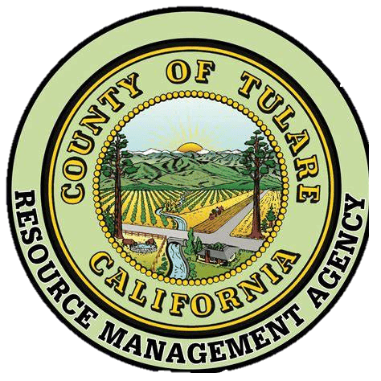


Stakeholder Meeting for Climate Adaptation and Resilience Plan
March 27, 2025

Slide 2
Welcome and Introductions

Slide 3
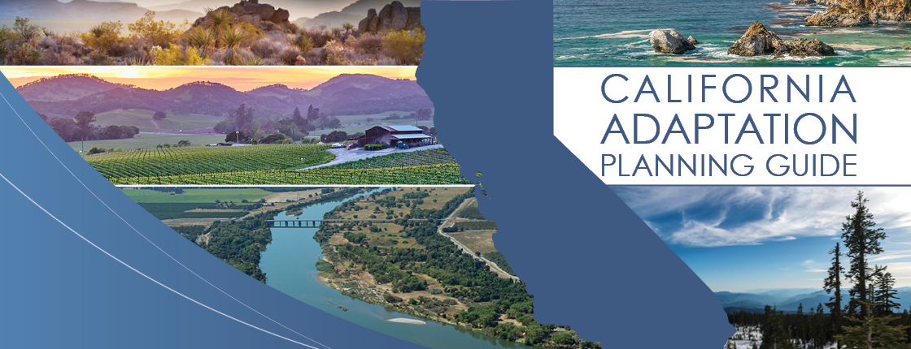
Introducing the California Adaptation Planning Guide (APG)

Slide 4
What is the California APG?
A detailed step-by-step process to guide communities on identifying vulnerabilities and developing mitigation strategies based on climate change impacts.
This guide has been used throughout the development of Tulare County’s Climate Adaptation and Resilience Plan (CARP).
https://www.caloes.ca.gov/wp-content/uploads/Hazard-Mitigation/Documents/CA-Adaptation-Planning-Guide-FINAL-June-2020-Accessible.pdf

Slide 5
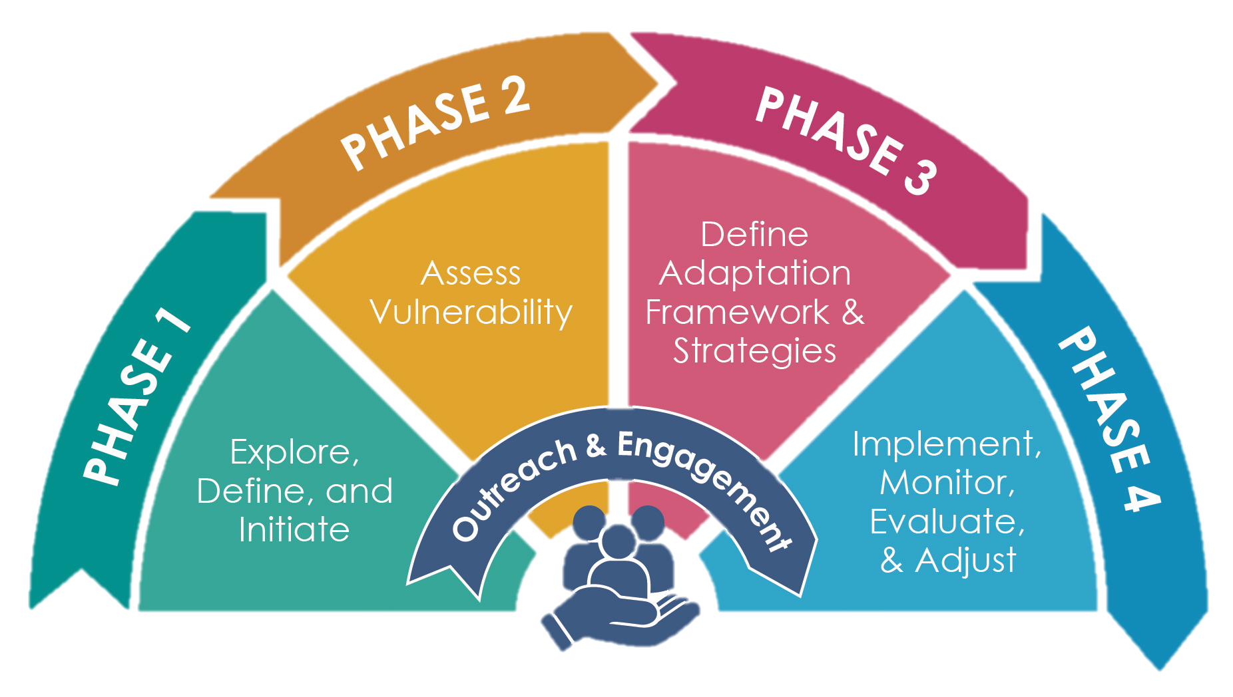
Planning Phases for CARP

Slide 6
Phase 1: Explore, Define, and Initiate

Slide 7
Step 1.1: Motivation and Scope
APG Guidelines
Clarify why the County is conducting an adaptation planning process.
Identified desired outcomes of process
Define resilience
Set geographic and time frame boundaries
Our Progress
Recent hazard events, regulatory requirements, and funding opportunities.
Identify hazards of concern in planning area; improve community resilience.
“The capacity of any entity (an individual, community, organization, or a natural system) to prepare for disruptions, to recover from shocks and stresses, and to adapt and grow from a disruptive experience.
Focus on vulnerable communities within Tulare County; Update at least every eight years following the Housing Element Update

Slide 8
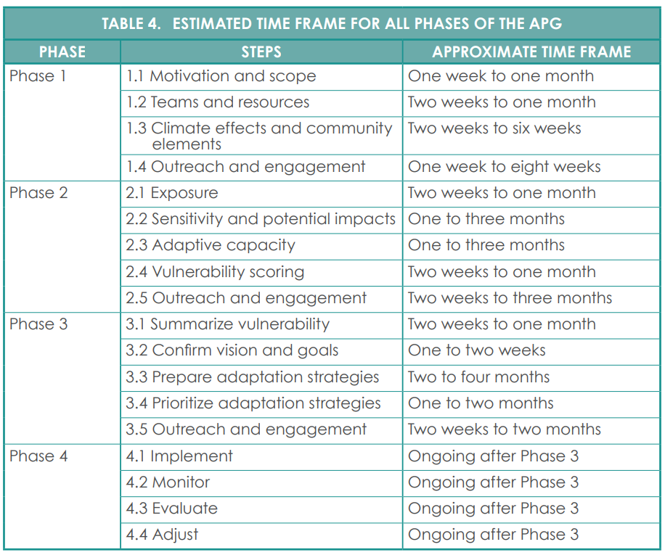
Step 1.1: Motivation and Scope

Slide 9
Step 1.1: Motivation and Scope – Regulatory Requirements
Senate Bill (SB) 379 Government Code Section 65302 (g)(4) requires:
  The creation of long-term plans that include climate adaptation and resilience strategies;
  A vulnerability assessment and goals/policies/objectives based on the assessment;
  And a list of achievable implementation measures.
SB 1035 Government Code Section 65302(g)(3) requires:
  That local governments review and update their Safety Elements whenever updates are made to the Housing Element or Local Hazard Mitigation Plan (LHMP);
  Plans to be updated no less than every eight years.
SB 1000 requires:
  That local governments identify disadvantaged communities in their jurisdictions;
  And to address environmental justice in local general plans.
Assembly Bill (AB) 747 requires:
  The review and updates of local government Safety Elements;
  Updated information such as identified evacuation routes and their capacity, safety, and viability under various emergency situations.

Slide 10
Step 1.2: Teams and Resources
APG Guidelines
Assemble project team
Identify tools and resources
Our Progress
RMA Staff, TC Departments, CivicSpark Fellows & Stakeholders
Tools and resources identified:
  California Adaptation Planning Guide
  California’s 4th Climate Change Assessment
  California Climate Adaptation Strategies
  California State Hazard Mitigation Plan
  CalEnviroScreen 4.0
  National Risk Index

Slide 11
Step 1.3: Climate Effects and Community Elements
APG Guidelines
Identify climate effects
Select populations and assets at risk for climate effects
Our Progress
Vulnerability assessment from the 2023 MJLHMP will be referenced in CARP.
Assets and populations at risk have been identified in the 2023 MJLHMP.
The 2023 Environmental Justice Element Disadvantaged Communities list

Slide 12
Step 1.3: Climate Effects and Community Elements – Disadvantage Communities
Allensworth
Alpaugh
Cutler-Orosi
Terra Bella
Delft Colony
Ducor
East Orosi
East Porterville
El Monte Mobile Home
Goshen
Hypericum
Ivanhoe
Jones Corner
Jovista
London
Matheny Tract
Monson
Okieville
Paige
Peral
Pixley
Plainview
Ponca
Poplar-Cotton Center
Richgrove
Strathmore
Sultana
Teviston
Tipton
Tooleville
Tonyville
Traver
Vance
Waukena
West Goshen
Woodville
Worth
Yettem
Zante

Slide 13
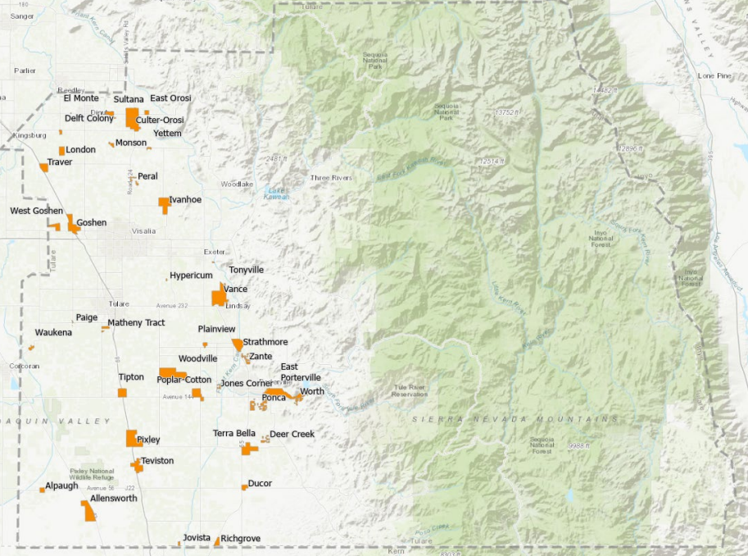
Step 1.3: Climate Effects and Community Elements – Disadvantage Communities

Slide 14
Phase 2: Assess Vulnerability

Slide 15
Step 2.1: Exposure
APG Guidelines
Confirm hazards
Describe historical hazards
Describe how hazards are expected to change
Map hazards
Our Progress
Using the list of hazards in the SHMP and MJLHMP update, hazards that were identified and confirmed that would be influenced by climate change.
A section listing and describing historical hazards in Tulare County has been developed.
A section describing projected changes in hazards has been developed.
Maps depicting hazards are in the process of being created.

Slide 16
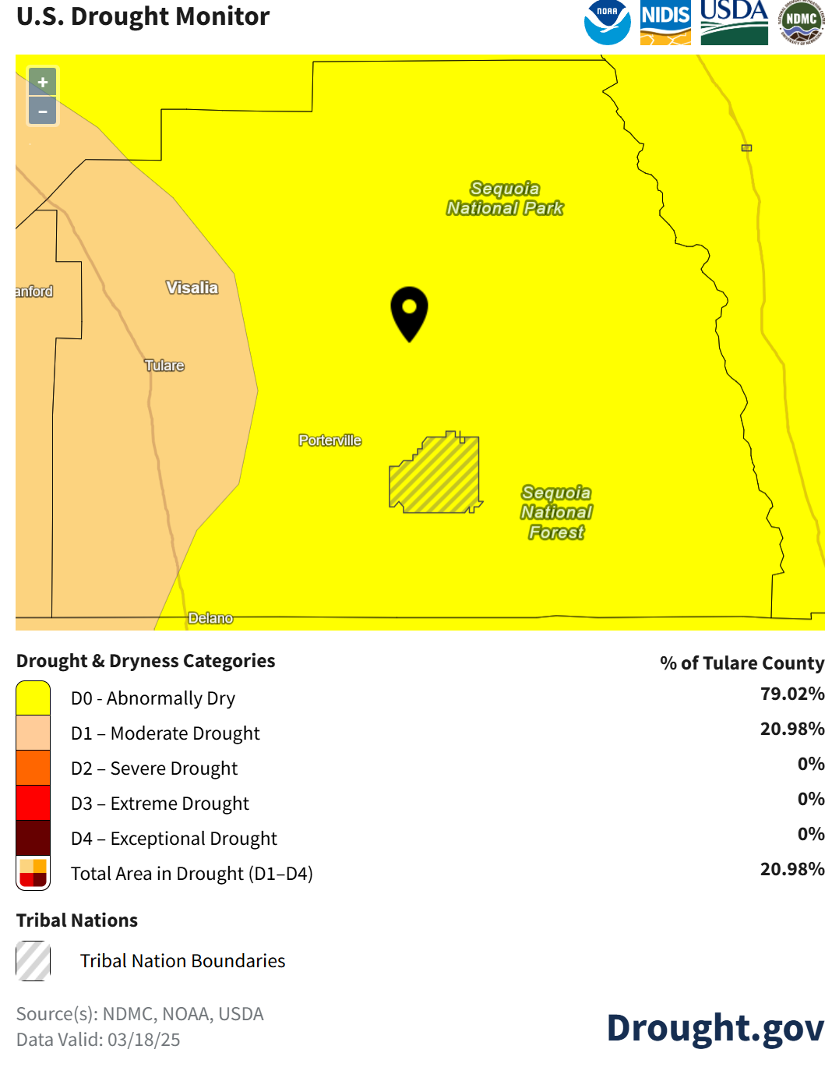
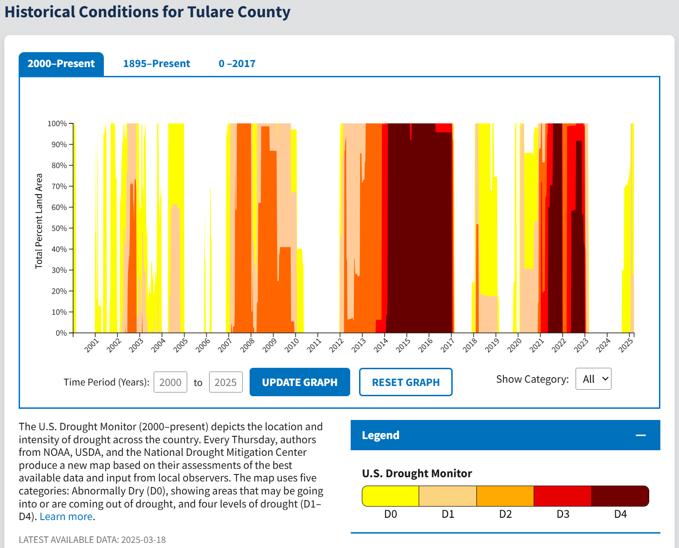
Step 2.1: Exposure – Drought Zones
https://www.drought.gov/current-conditions

Slide 17
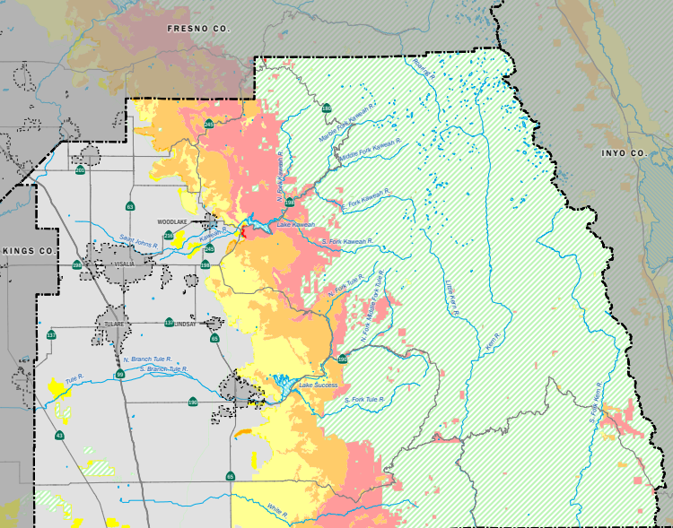
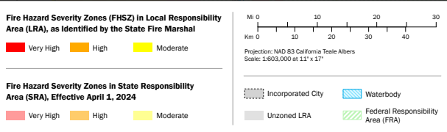
Step 2.1: Exposure – Fire Hazard Severity Zones

Slide 18
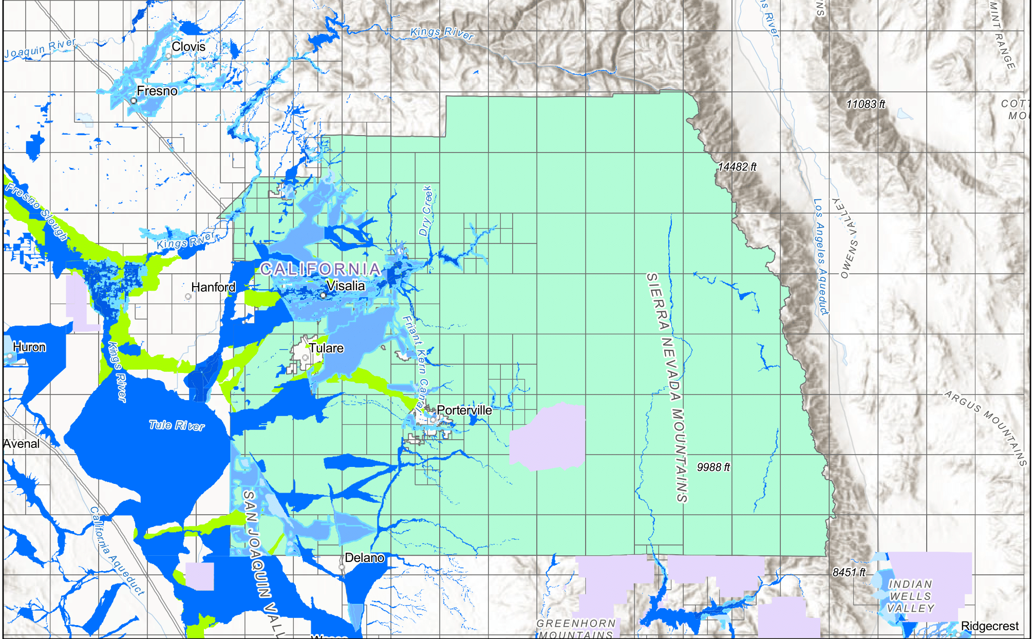
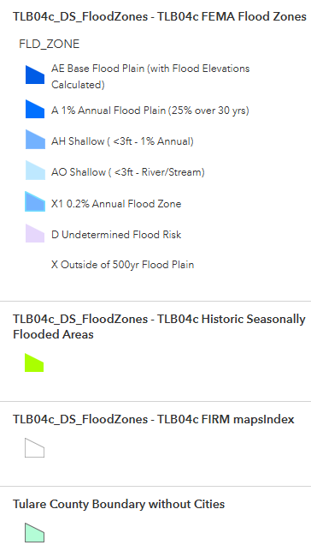
Step 2.1: Exposure – Flood Zones

Slide 19
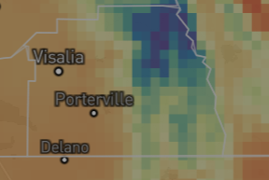
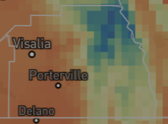
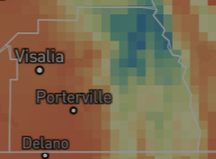
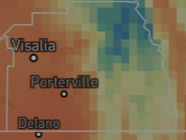
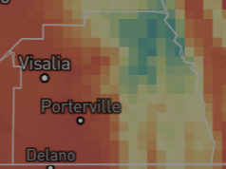
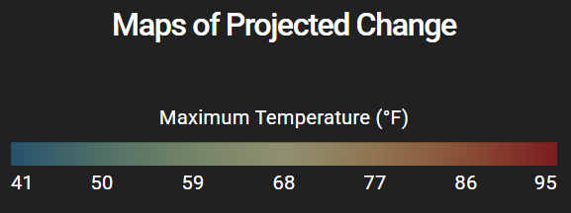
Step 2.1: Exposure – Extreme Heat
Historical Baseline (1961-1990)
Mid-Century (2035-2064)
End of Century (2070-2099)
Medium Emissions (RCP 4.5)
Medium Emissions (RCP 4.5)
High Emissions (RCP 8.5)
High Emissions (RCP 8.5)
https://cal-adapt.org/tools/maps-of-projected-change

Slide 20
Step 2.2: Sensitivities and Potential Impacts
APG Guidelines
Confirm community populations and assets
Identify historical and potential future climate impacts
Identify potential climate impacts of greatest concern
Our Progress
Data from Census Bureau used to confirm population demographics.
Climate impacts were identified using historical disaster declarations.
Using historical disaster impacts and projected climate impacts, hazards of greatest concern were identified.

Slide 21
Step 2.3: Adaptive Capacity
APG Guidelines
Review documents to collect information on adaptive capacity
Interview local agencies on ability to enhance adaptive capacity
Our Progress
List of documents being used as reference
  Tulare County 2023 MJLHMP
  Tulare County 2023 Environmental Justice Element
  Tulare County 2023 Housing Element
  Tulare County Emergency Operations Plan

Slide 22
Step 2.4: Scoring Vulnerability
APG Guidelines
Score vulnerability
Summarize vulnerability
Our Progress
Use MJLHMP vulnerability and risk assessment
Focus on creating an accurate table that describes hazard vulnerability

Slide 23
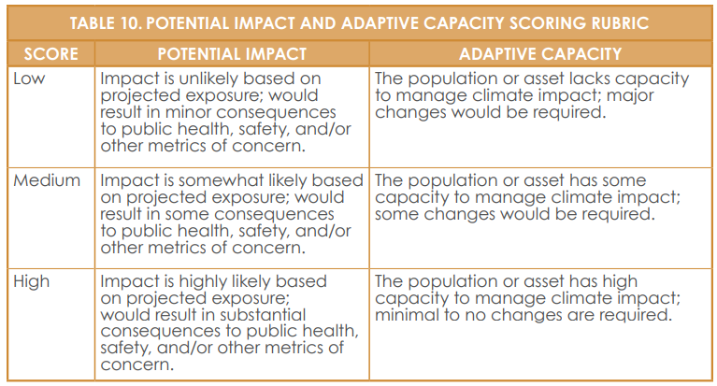
Step 2.4: Scoring Vulnerability

Slide 24
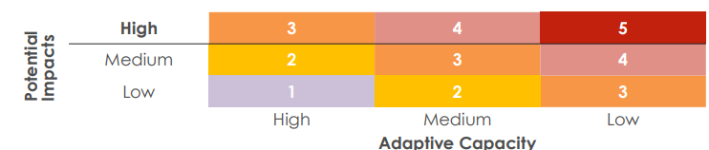
Step 2.4: Scoring Vulnerability

Slide 25
Phase 3: Define Adaptation Framework and Strategies

Slide 26
Step 3.1: Summarize Vulnerability
APG Guidelines
Summarize vulnerability
Our Progress
Vulnerability assessment from Phase 2

Slide 27
Step 3.2: Confirm Vision and Goals
APG Guidelines
Confirm vision
Draft goals
Our Progress
Five goals identified:
  Protect life, property, and reduce potential injuries from natural, technological, and human-cause disasters;
  Improve public understanding, support and need for hazard mitigation measures.
  Promote disaster resistance for the County’s natural, existing, and future built environment.
  Strengthen partnerships and collaboration to implement hazard mitigation activities.
  Enhance the County’s ability to effectively and immediately respond to disasters.

Slide 28
Step 3.3: Prepare Adaptation Strategies
APG Guidelines
What is a strategy?
How to draft a strategy
Our Progress
Programmatic
Plans, regulations, and policy development
Capital improvement/infrastructure projects Education/outreach/coordination
Evaluation

Slide 29
Step 3.4: Prioritize Strategies
APG Guidelines
Society and equity
Economy
Environment
Governance
Our Progress
Vulnerability Score
Administrative Operability
Cost/Funding
Effectiveness/benefits
Environmental performance
Legality
Responsiveness/appropriateness
Timing
Monitoring

Slide 30
Step 3.5: Outreach and Engagement
APG Guidelines
Project team should categorize and prioritize strategies
Community outreach to develop adaptation strategies
Ensure equitable adaptation strategies
Our Progress
Stakeholder meetings
Booths at community events

Slide 31
Phase 4: Implement, Monitor, Evaluate, and Adjust

Slide 32
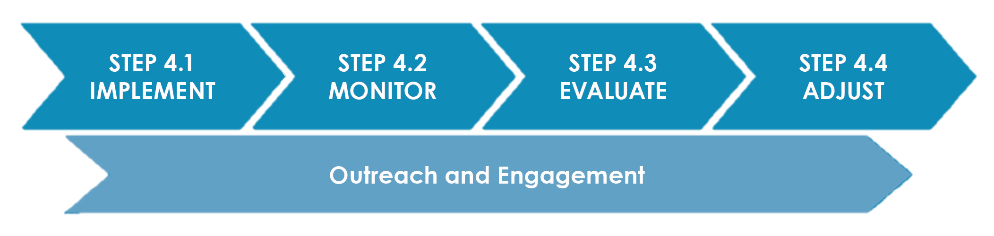

Slide 33
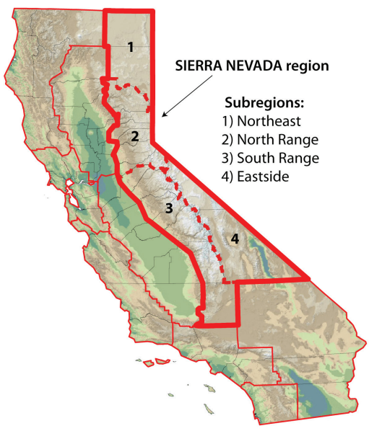
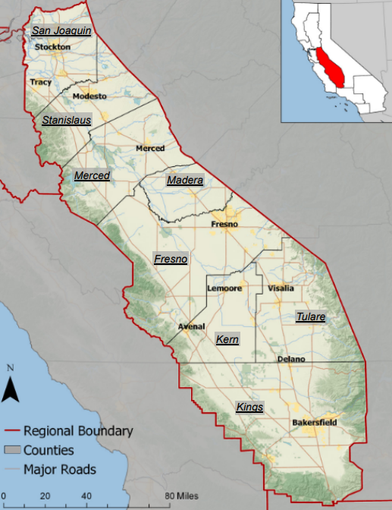
California Climate Adaptation Strategy
California Climate Adaptation Strategy Workshops and Regional Reports:
  https://climateresilience.ca.gov/regions/sierra-nevada.html
  https://climateresilience.ca.gov/regions/san-joaquin-valley.html
California’s Fourth Climate Change Assessment
    The Fifth Climate Change Assessment is currently in progress

Slide 34
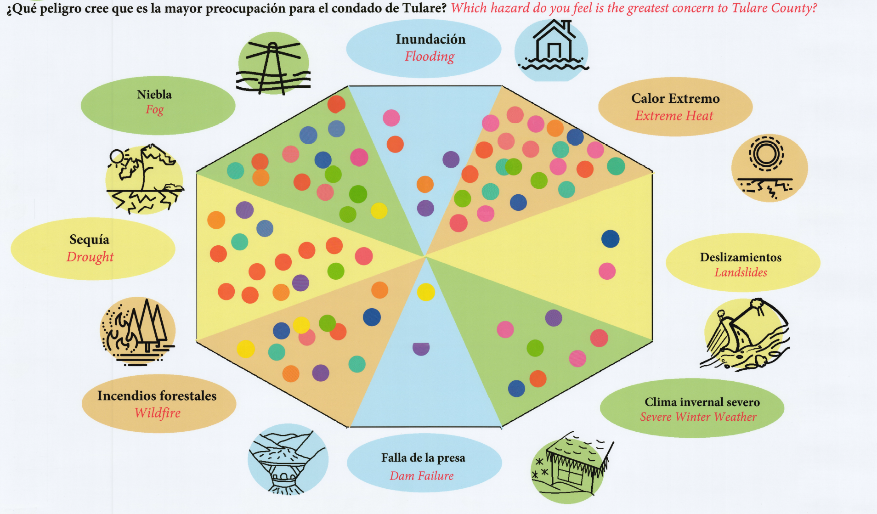
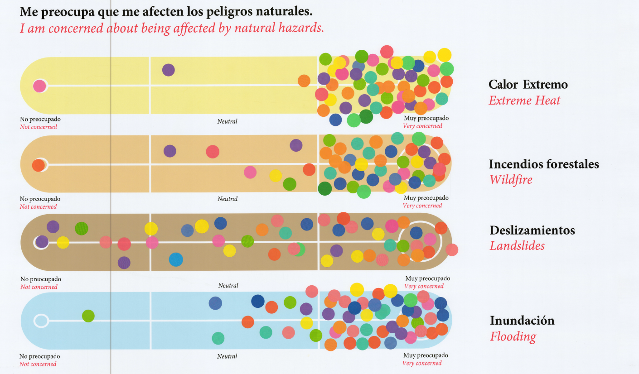
Tulare County Community Outreach
2024 Lindsay Orange Blossom Festival
2024 Cutler-Orosi Community Resource Fair

Slide 35
Any Questions?

